Slide 1
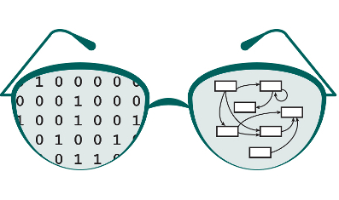

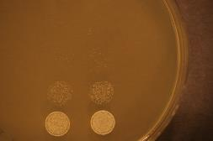
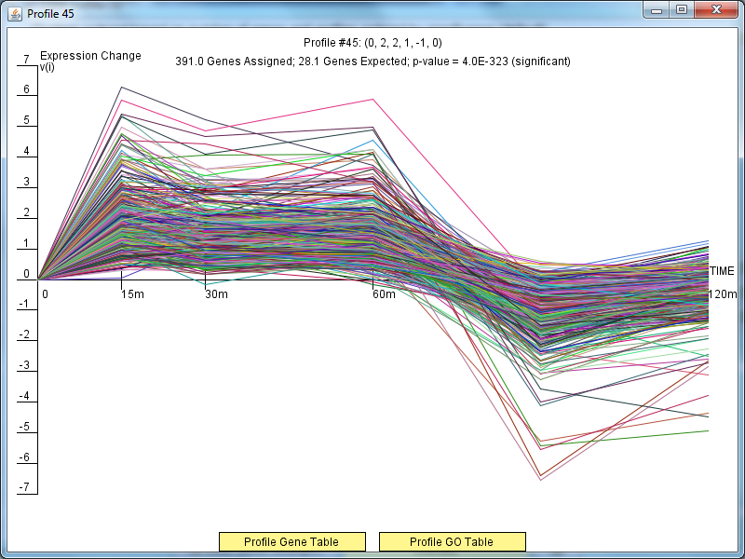
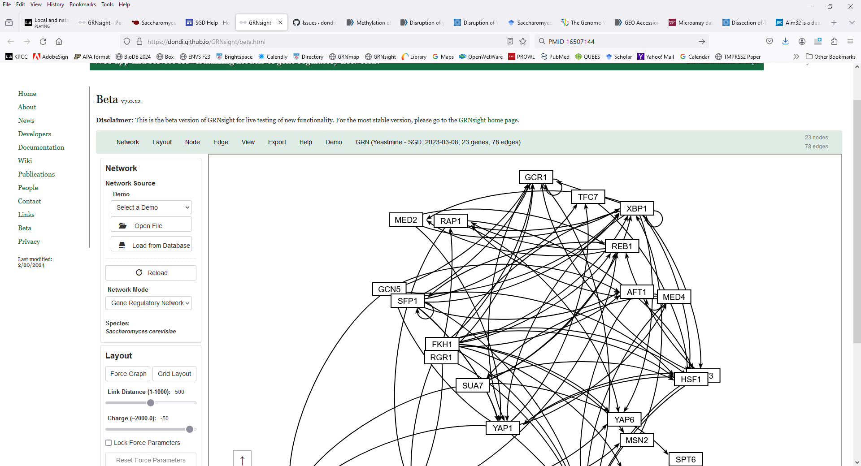
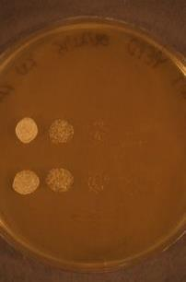
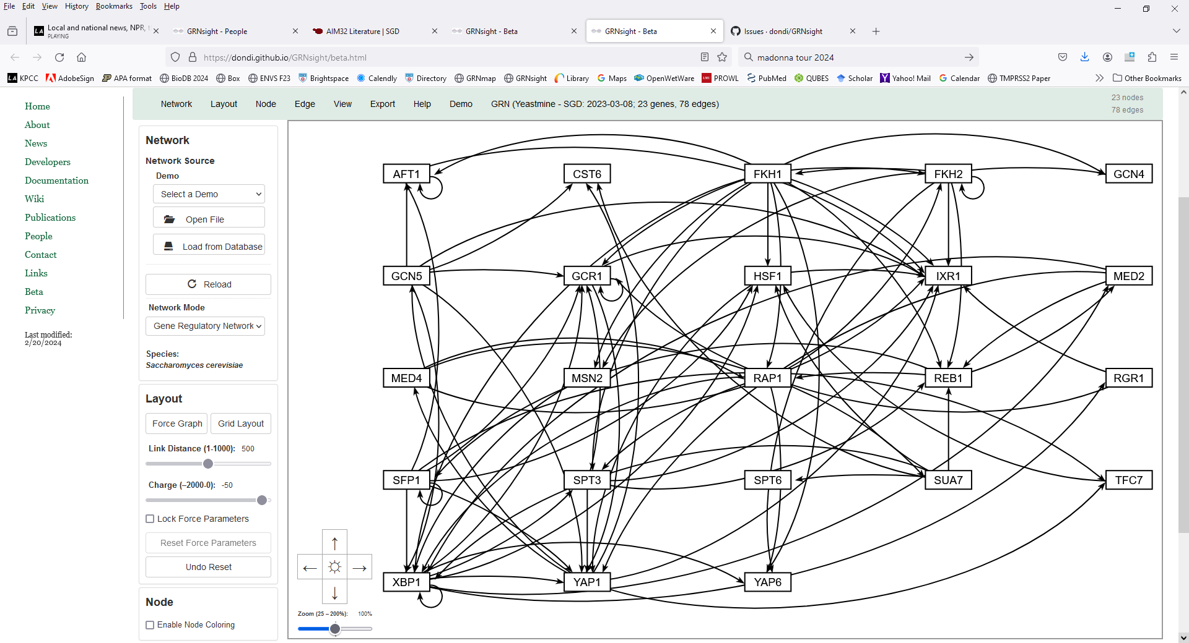
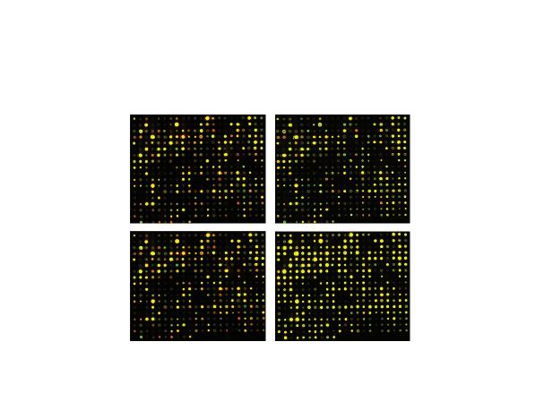
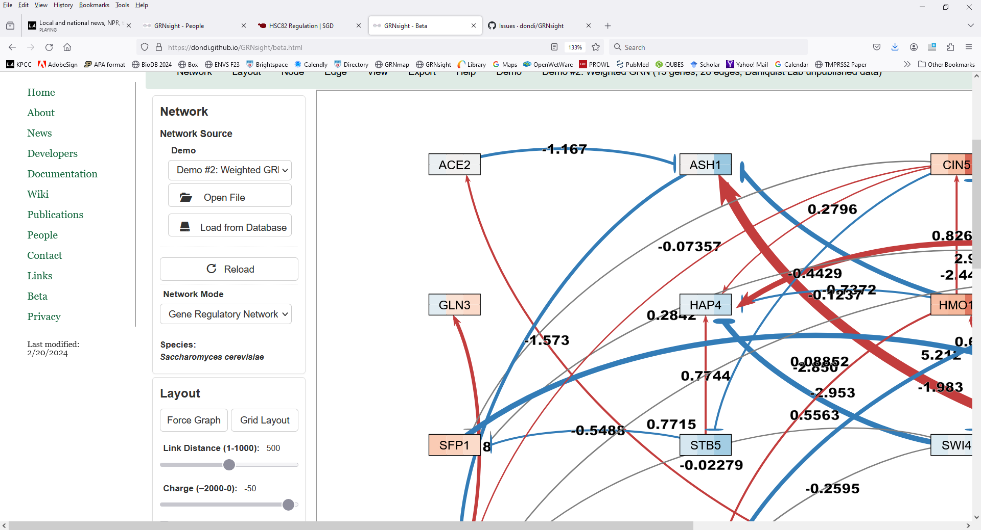
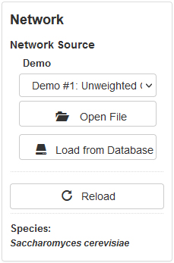
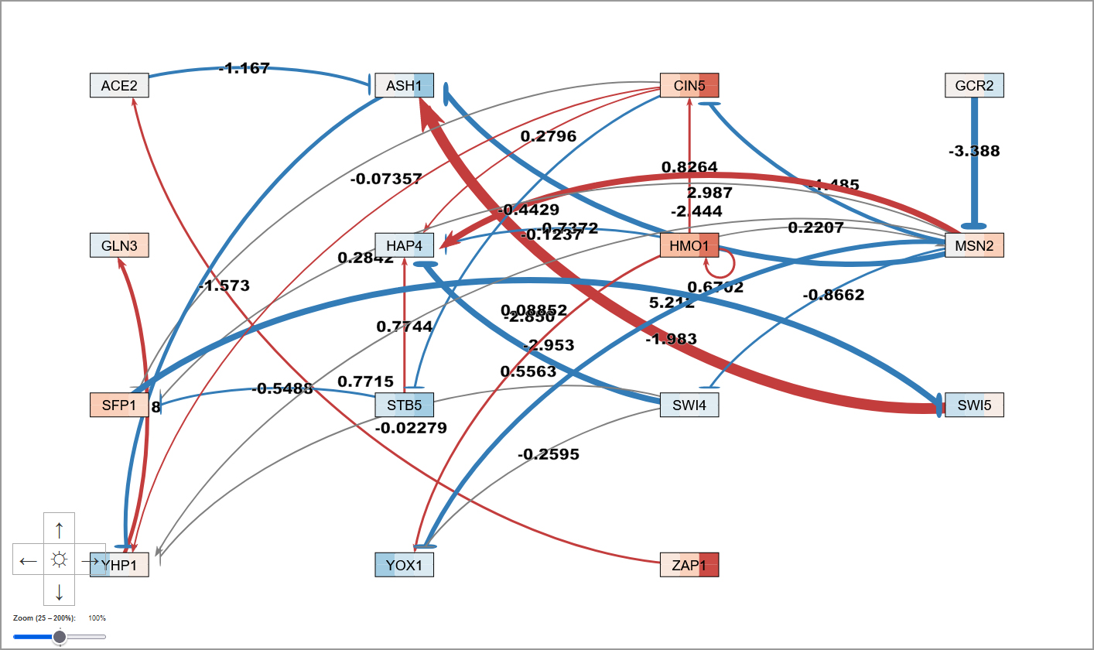
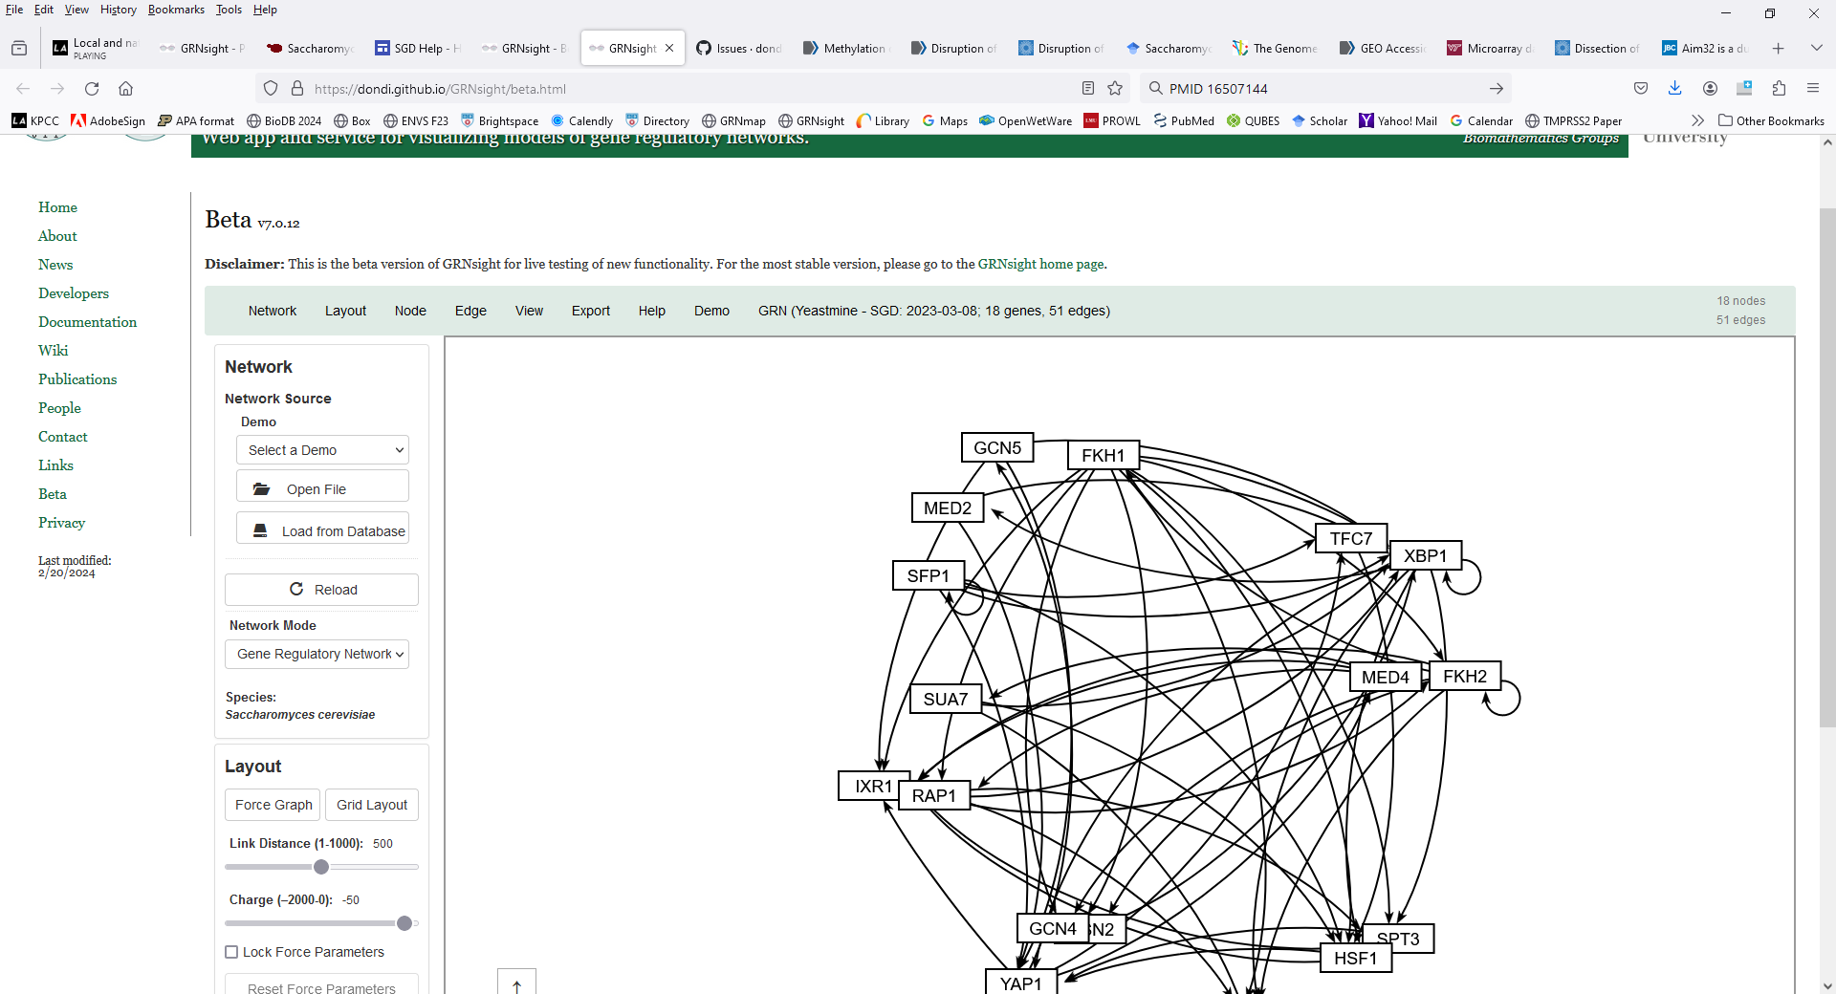
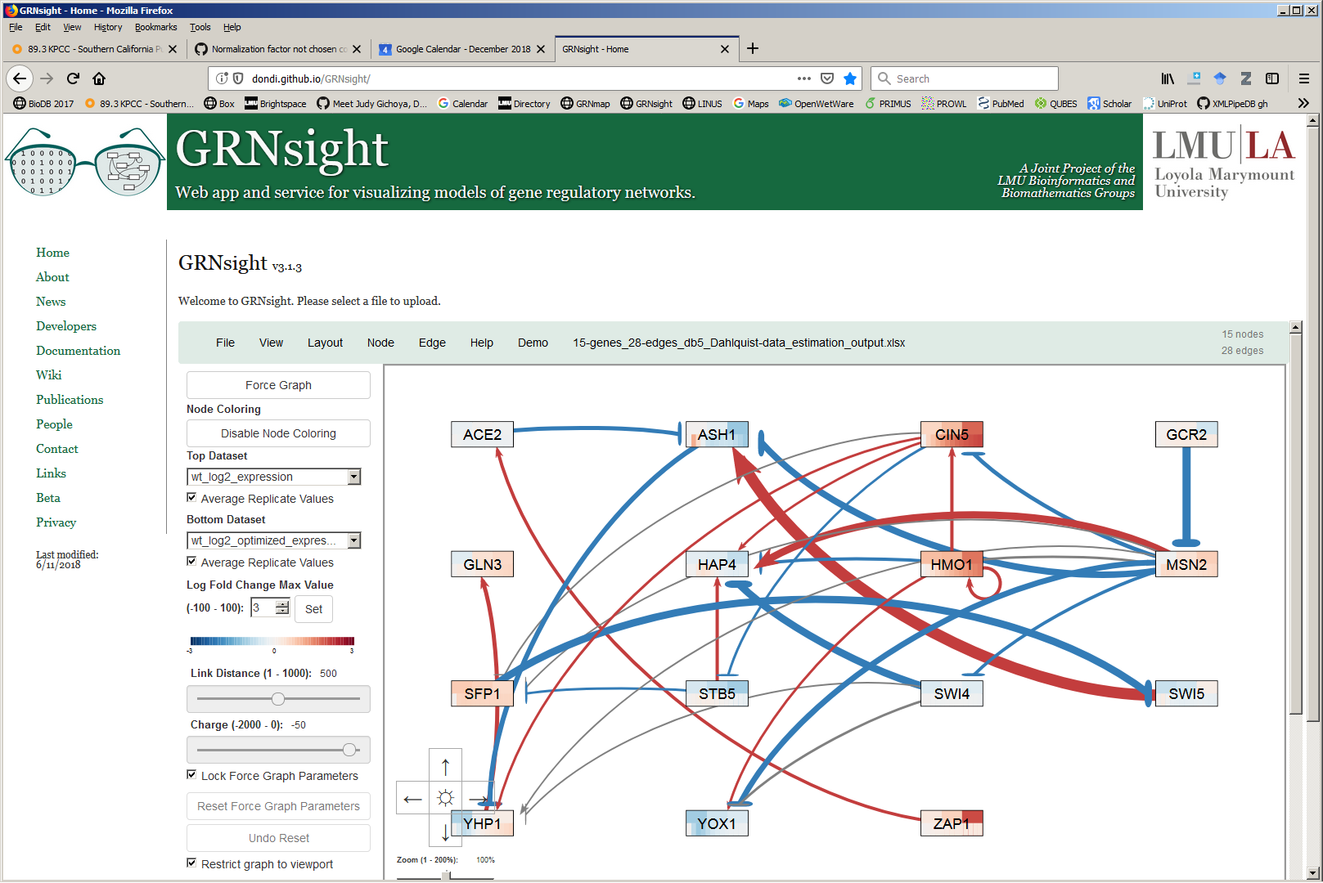
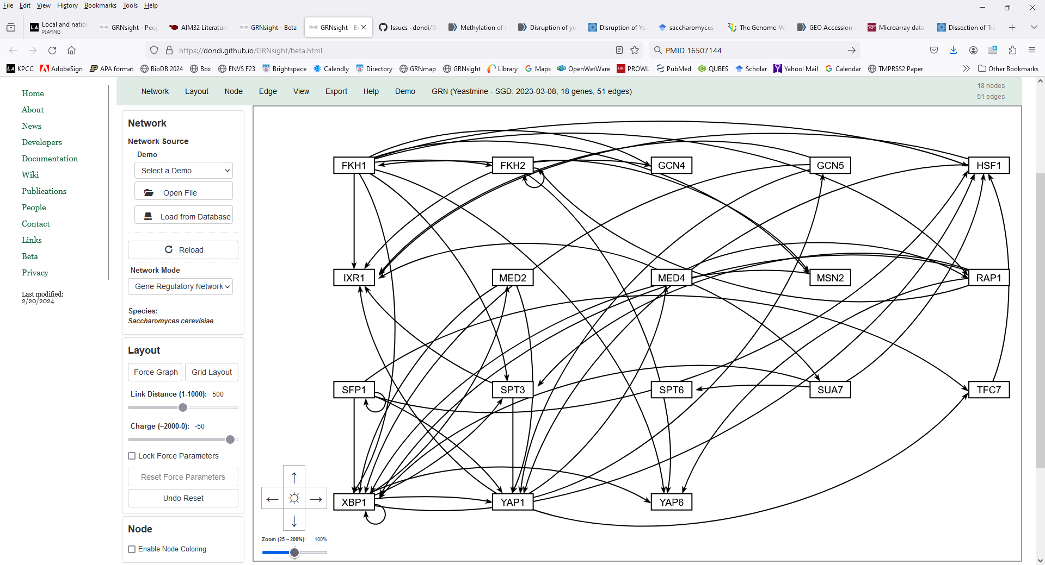
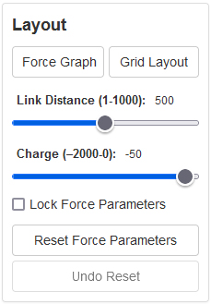
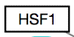
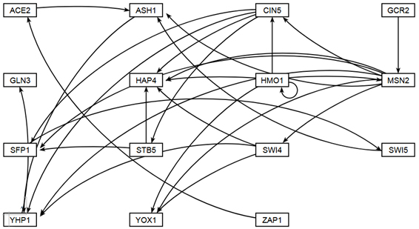
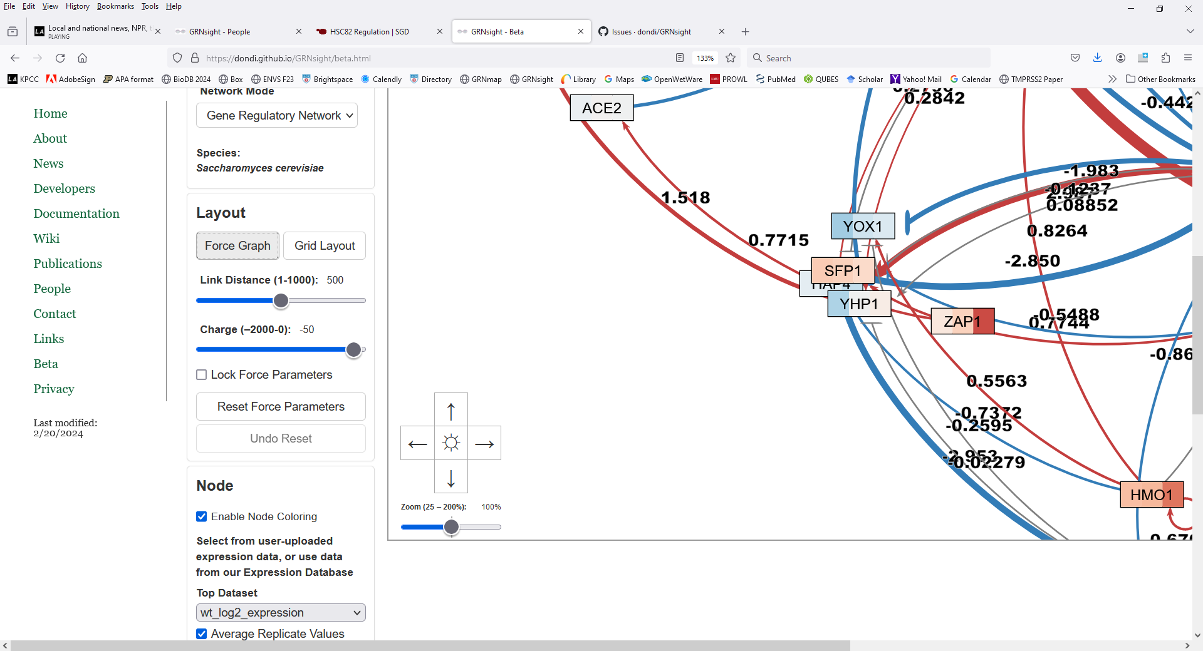
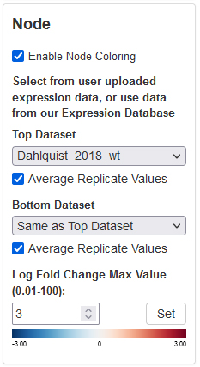
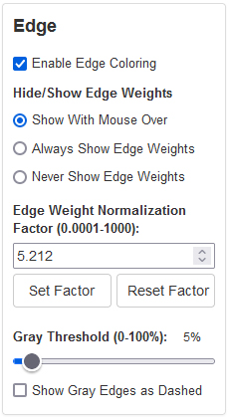
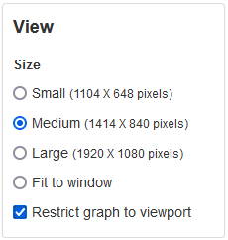
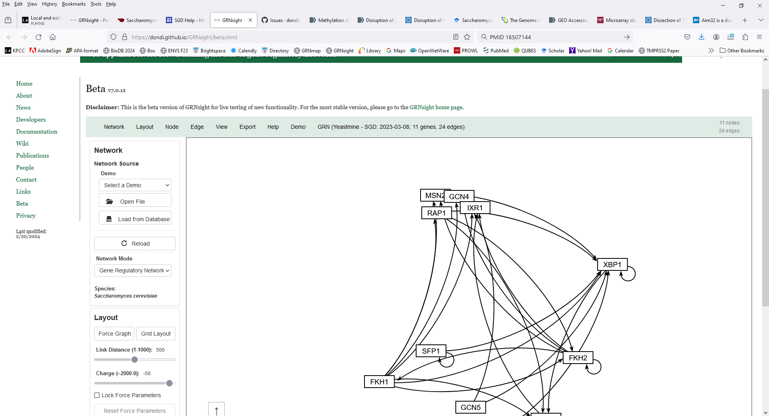
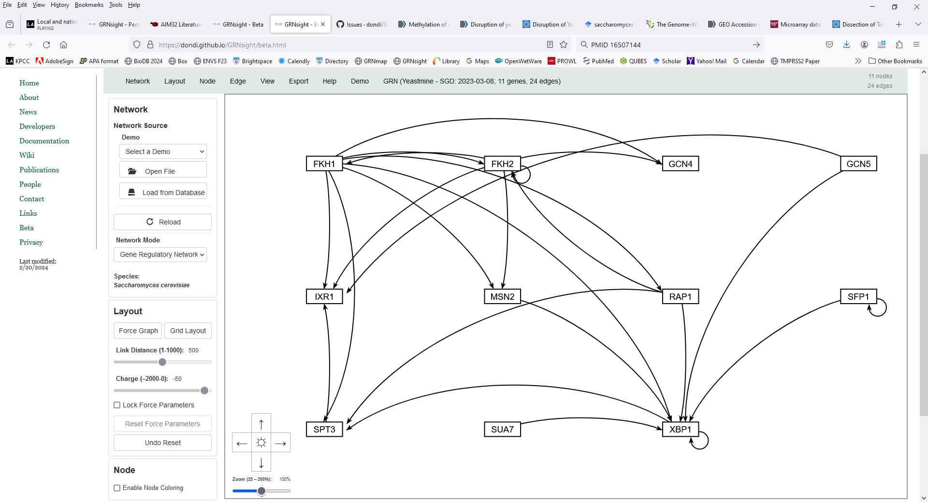
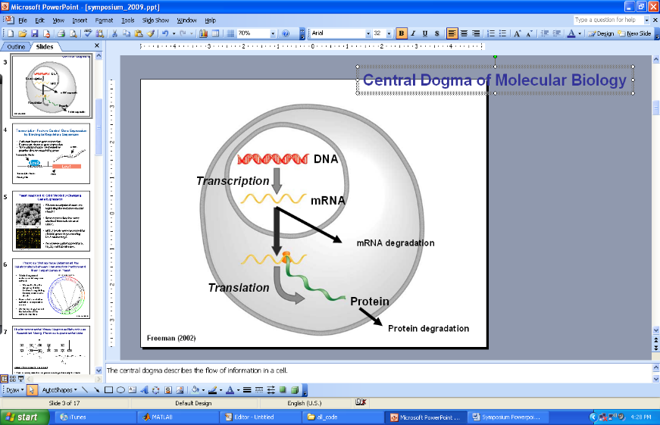
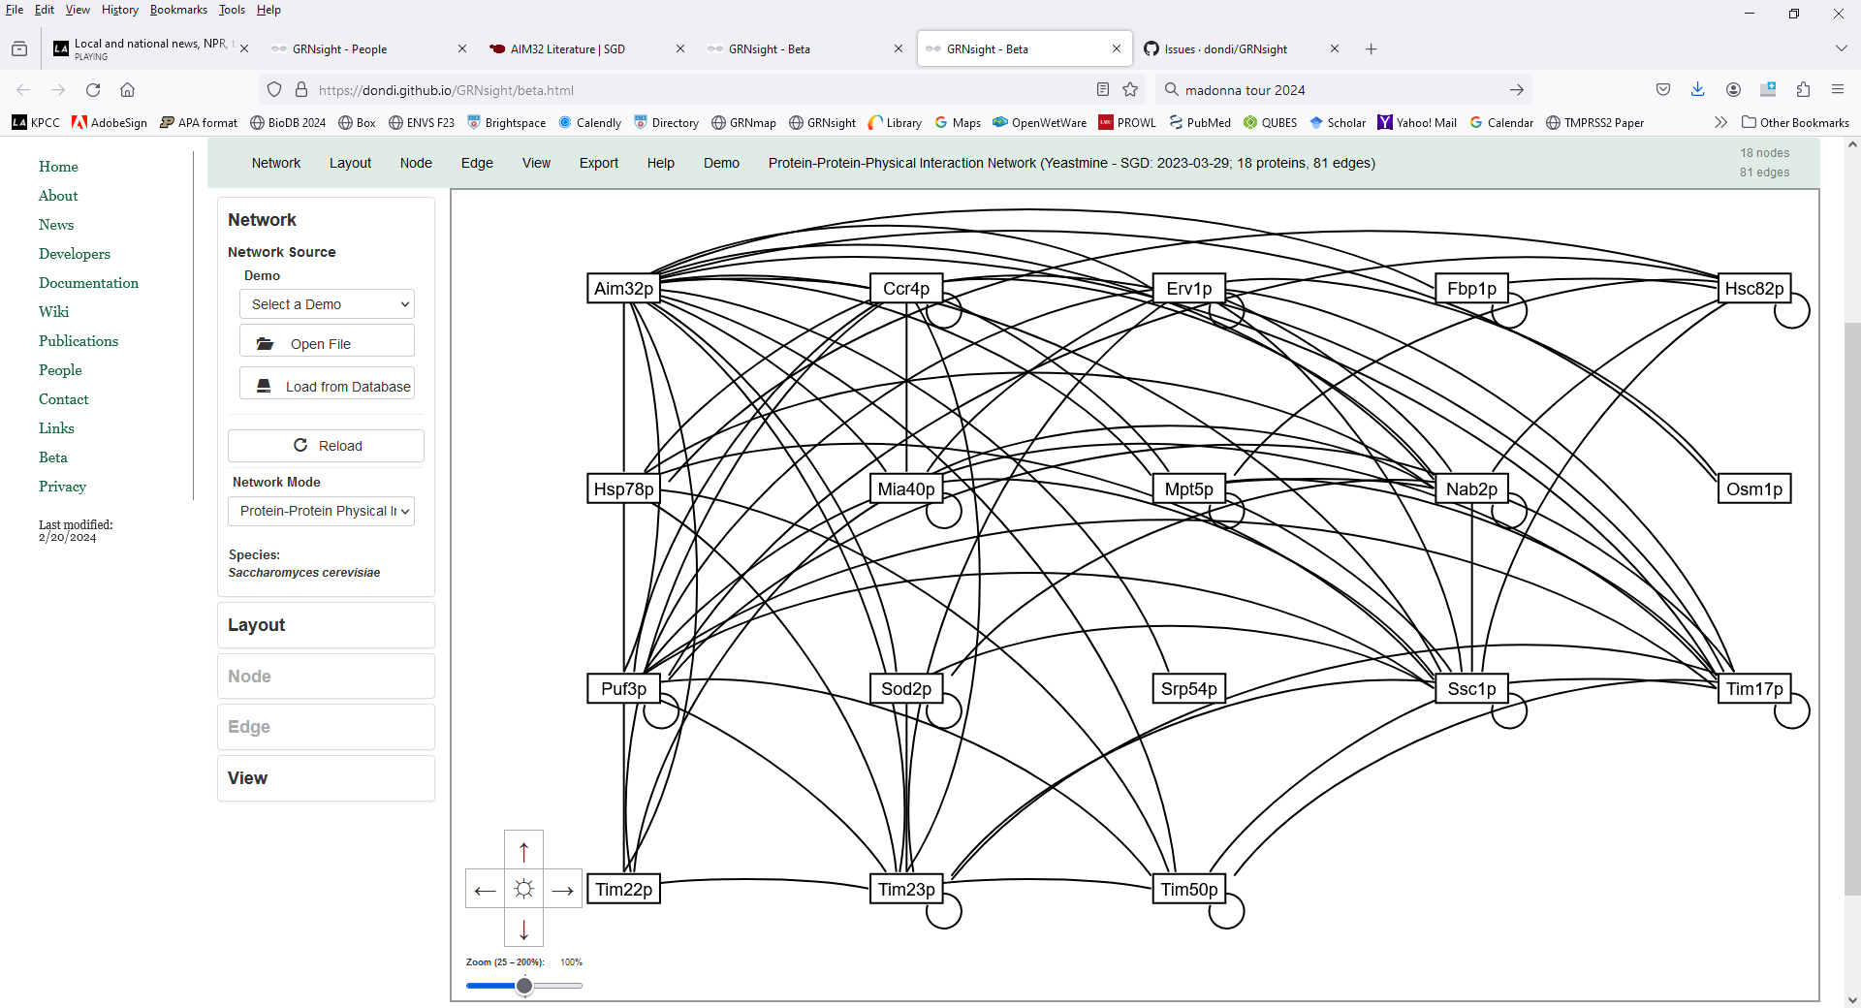
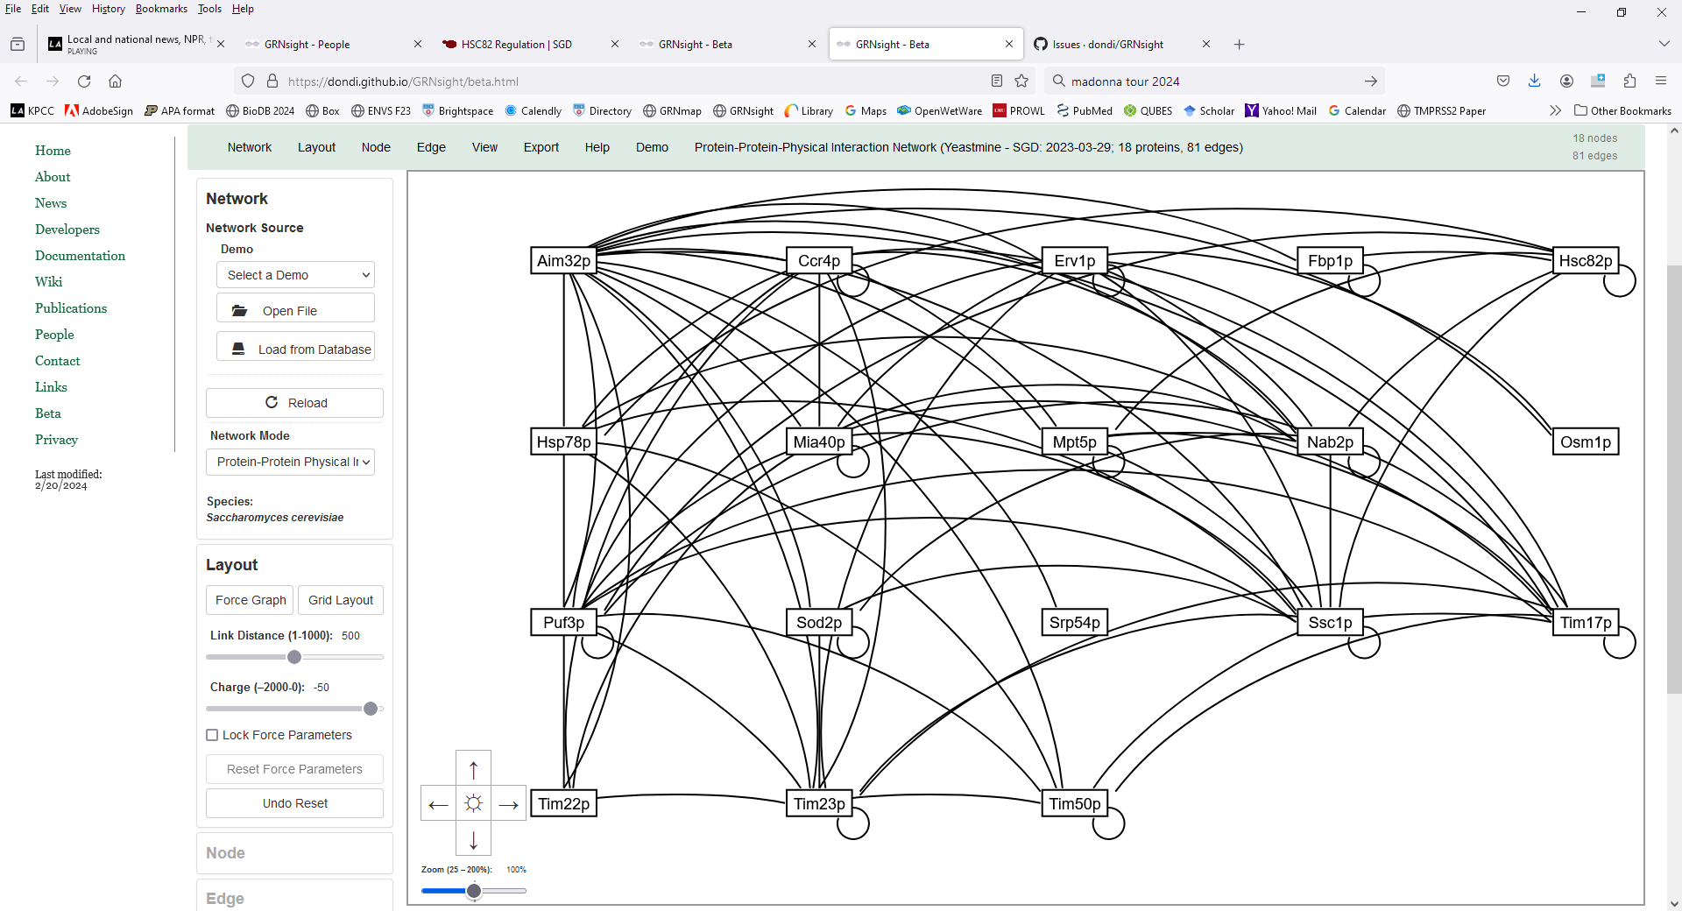
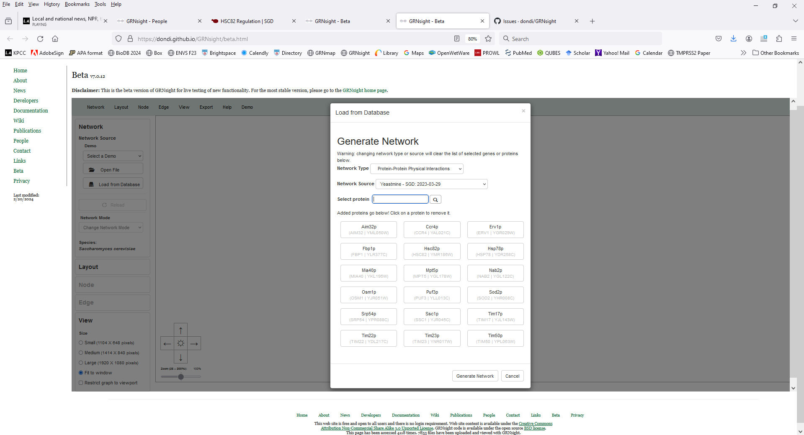
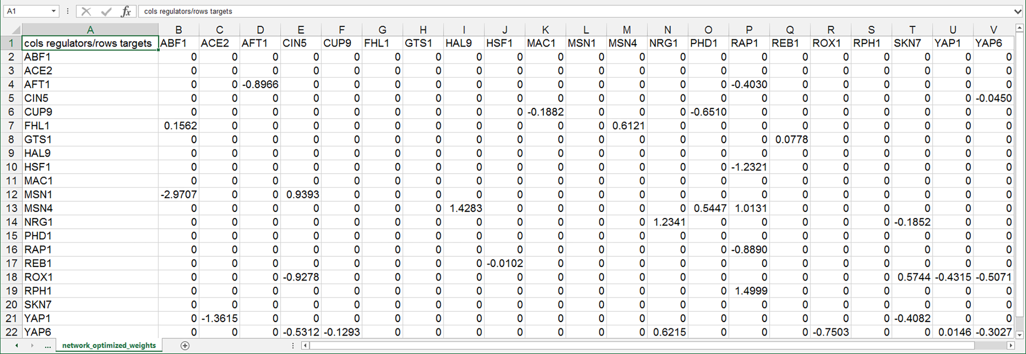
Extending the GRNsight application for visualizing small-to-medium gene regulatory networks to incorporate physical protein-protein interaction data from SGD
Kam D. Dahlquist¹, Onariaginosa O. Igbinedion², Ahmad R. Mersaghian¹, Ngoc K. Tran², Deepa V. Dabir¹, John David N. Dionisio²
Departments of ¹Biology and ²Computer Science, Loyola Marymount University, 1 LMU Drive, Los Angeles, CA 90045 USA
http://kdahlquist.github.io/GRNmap/ and http://dondi.github.io/GRNsight/
We have previously used a systems biology approach to understand the regulation of the cold shock response in yeast
GRNsight, automatically lays out the network graph, coloring the edges based on weight values, and the nodes based on experimental or simulated expression data
Goal is to facilitate comparisons between GRNs
and PPI graphs for the same phenomenon
wt
15°C
Cold shock microarray data from wt and TF deletion strains
Network
Demo files are provided.
Can import and export Excel, SIF, or GraphML files.
Can construct a network from SGD regulation or PPI data stored in a backend database.
Layout
Users can select a force graph layout or grid layout.
Force graph parameter sliders:
Link distance determines the minimum distance between nodes.
Nodes have a charge which repels or attracts other nodes.
Node
Coloring can be based on user-uploaded expression data or from published expression datasets stored in a backend database.
Datasets available:
Apweiler et al. 2012, GSE33098
Barreto et al. 2012, GSE24712
Dahlquist et al. 2018, GSE83656
Kitagawa et al. 2002, GSE9336
Thorsen et al. 2007, GSE6068
Edge
Edge coloring can be toggled on and off.
Buttons enable the user to always see edge weights, never see edge weights, or see edge weights upon mouseover.
Allows user to set normalization factor so that edge thicknesses for different graphs can be rendered on the same scale.
Changing the gray threshold deemphasizes weaker edges in the visualization.
Presenting gray edges as dashed lines further deemphasizes weak edges.
View
Multiple viewport sizes available.
Graph bounding box can be separated from viewport.
Zooming and scrolling available.
1
A list of transcriptional regulators for the 18 genes of the Aim32p PPI network were obtained from SGD.
A total of 64 unique regulators (out of 159 total) were annotated to the 18 Aim32p PPI genes.
They were mostly annotations from high-throughput data.
The number of regulators annotated per gene:
Minimum: 0 (OSM1)
Maximum: 20 (HSC82)
Median: 7
Average: 9
Mode: 4
The most common regulators, FKH1, FKH2, and GCN5, were annotated to 8 genes.
GRNs were generated from transcriptional regulators annotated in common among the genes.
23 regulators annotated to
3 or more genes
18 regulators annotated to
4 or more genes
11 regulators annotated to
5 or more genes
Δash1
1
Interpretation,
new questions, new experiments
Normalization, statistical analysis, clustering
Visualization of modeling results using GRNsight
Derivation of gene regulatory networks from databases
2
Dynamical systems modeling using GRNmap
Key
A “medium-scale” gene regulatory network that regulates the cold shock response
gene
activation
2
repression
Each node represents one gene encoding a transcription factor.
Each edge represents a regulatory relationship, either activation or repression, depending on the sign of the weight.
This network was derived from the YEASTRACT database.
3
4
5
weak influence
3
GRNmap: Gene Regulatory Network modeling and parameter estimation
Future Directions
*Some new features are only available in GRNsight v7.0.12 beta.
Automate the process of toggling between a particular PPI network and the GRN that regulates the genes encoding the proteins in the PPI network, as shown above.
Update the backend GRNsight GRN and PPI databases with 2024 data from SGD.
Provide additional time-course expression datasets for users to visualize on the GRN nodes.
Students in the Spring 2024 Biology 367 Biological Databases course at LMU will be processing two additional expression datasets for inclusion in GRNsight.
Dahlquist et al. (2015)
GRNsight can now be used to visualize protein-protein physical interaction (PPI) networks
P_{i}
Model is coded in MATLAB.
Input Excel workbook contains:
Network adjacency matrix
Timecourse expression data
mRNA degradation rates
Output workbook contains optimized:
Production rates, P
Threshold b
Weight parameters, w, give the direction (activation or repression) and magnitude of the regulatory relationship
We previously created a backend database for GRNsight with SGD regulation data gathered from YeastMine.
We have now included SGD-derived Protein-Protein Physical Interactions (PPI) in the database.
Users can now select proteins that they want to include in the PPI network from within GRNsight.
d_{i}
Freeman (2002)
Availability
GRNsight is free and open to all users at http://dondi.github.io/GRNsight/, and there is no login requirement.
GRNsight code is available under the open source BSD license at our GitHub repository at https://github.com/dondi/GRNsight.
GRNmap MATLAB code and executable can be downloaded from http://kdahlquist.github.io/GRNmap/downloads.html
under the BSD license.
Some new GRNsight features are only available in
GRNsight v7.0.12 beta.
GRNmap produces an Excel workbook with optimized parameters
Acknowledgments
We would like to thank the previous developers on the GRNmap and GRNsight projects, and new students Nikki C. Chun, A'Kaia Phelps, and Cecilia J. Zaragoza.
References
Example of an 18-protein, 81-edge network representing proteins that interact with Aim32p.
Aim32p is a dual-localized 2Fe-2S mitochondrial protein that functions in redox quality control.
Unlike GRNs, PPI graphs have undirected edges of uniform thickness and black color and
do not display expression data on the nodes.
Dahlquist, K.D., Fitzpatrick, B.G., Camacho, E.T., Entzminger, S.D., & Wanner, N.C. (2015) Parameter Estimation for Gene Regulatory Networks from Microarray Data: Cold Shock Response in Saccharomyces cerevisiae. Bulletin of Mathematical Biology, 77(8), 1457-1492. doi: 10.1007/s11538-015-0092-6
Dahlquist, K.D., Dionisio, J.D.N., Fitzpatrick, B.G., Anguiano, N.A., Varshneya, A., Southwick, B.J., & Samdarshi, M. (2016) GRNsight: a web application and service for visualizing models of small- to medium-scale gene regulatory networks. PeerJ Preprints 4:e2068v1. doi: 10.7287/peerj.preprints.2068v1
Freeman, S. (2002) Biological Science. Upper Saddle River, New Jersey: Prentice Hall.
Wong, E. D., Miyasato, S. R., Aleksander, S., Karra, K., Nash, R. S., Skrzypek, M. S., Weng, S., Engel, S. R., & Cherry, J. M. (2023). Saccharomyces genome database update: server architecture, pan-genome nomenclature, and external resources. Genetics, 224(1), iyac191. doi: 10.1093/genetics/iyac191
Zhang, D., Dailey, O. R., Simon, D. J., Roca-Datzer, K., Jami-Alahmadi, Y., Hennen, M. S., Wohlschlegel, J. A., Koehler, C. M., & Dabir, D. V. (2021). Aim32 is a dual-localized 2Fe-2S mitochondrial protein that functions in redox quality control. Journal of Biological Chemistry, 297(4). doi: 10.1016/j.jbc.2021.101135
Screenshot of the Excel worksheet containing the optimized regulatory weights in the form of an adjacency matrix.
This format is directly read by GRNsight.
Notes:
Kill abstract
Change to sans serif font
Make title bigger
Make title background white
Use full names
Super script to associate names with correct department
Background color: make it dark green, make writing on white background and writing in black/dark green
4 columns!!!
Smaller pictures
Bold titles
References can be 12pt
Acknowledgements can be 16pt
Everything else is 18-24pt
Titles don’t need to be bigger than 36pt
Remove circles from the arrowhead diagram, group the related labels together
Include menu bar
Testing/error handling – sample error (we don’t crash with errors!)
Mouseovers for edges screenshot

